Slide 1

OutWrite
Marisa Yamasaki
Alisha Meherally
Kevin Jung
Fengjun Dong
Image from thenounproject.com

Slide 2
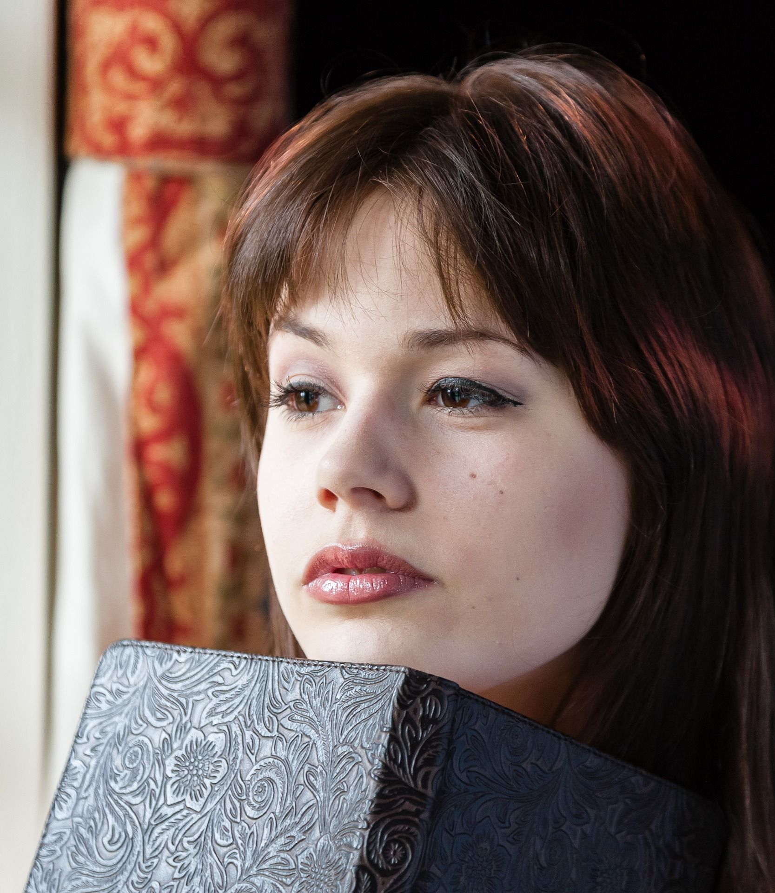
Meet the writer!
Robin -- a student who writes an hour every night
Comes up with ideas throughout the day, but loses her notes
https://pixabay.com/
Notes:
This is Robin. She’s a student, but she’s loved to read for years. She’s dealing with her classes, homework, and a job, but she wants to write a novel. She’s decided she can devote an hour to her project every night to write.
Robin comes up with ideas everywhere for her book, but she keeps losing whatever paper she writes them down on.
Robin also struggles keeping her characters and her plot in order, since she just started and she’s been writing them all over the place.

Slide 3
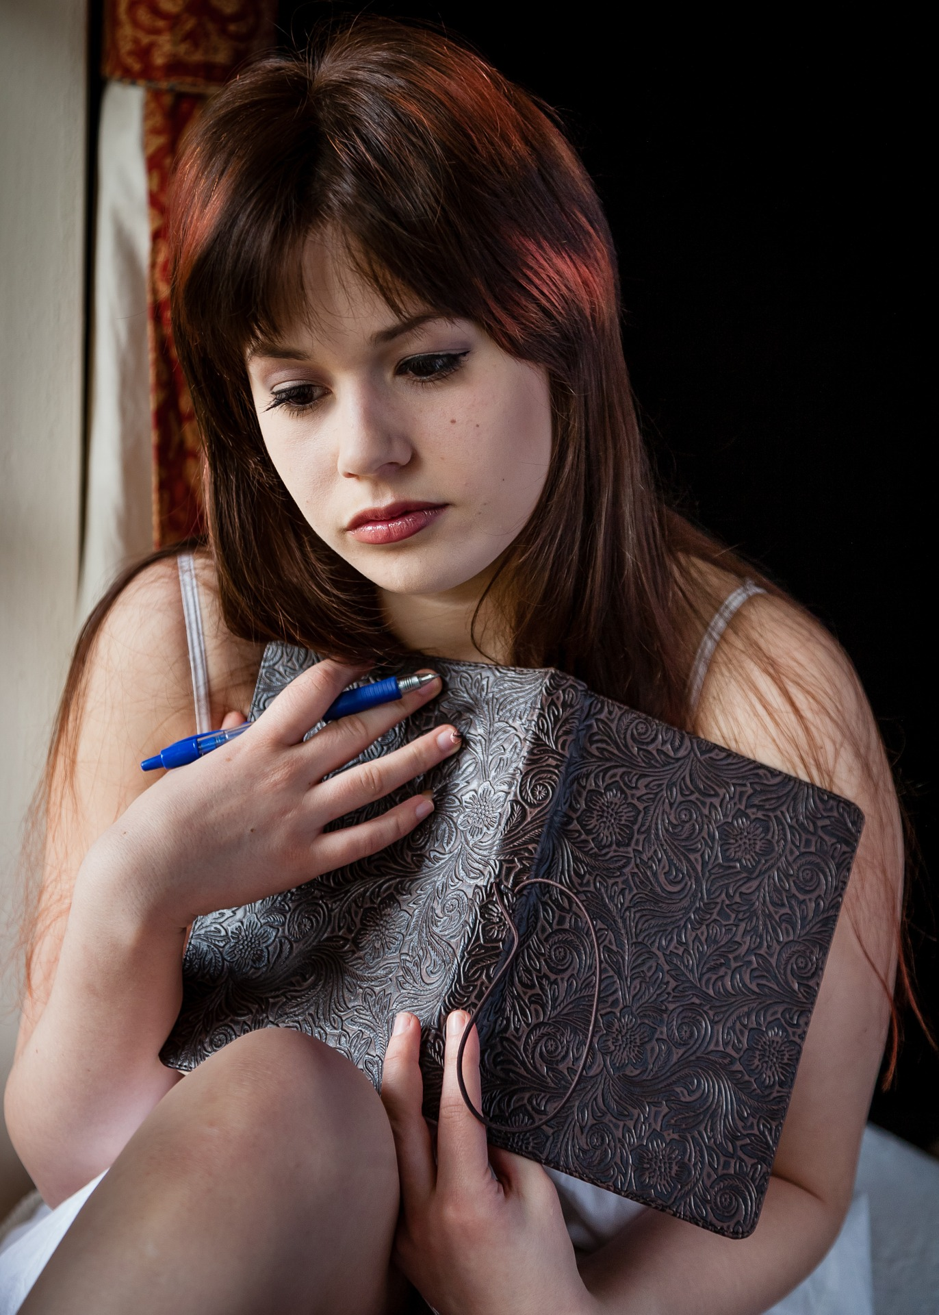
The problem
On her feet throughout the day; can’t write down ideas in a systematic way
Loses track of details about characters and plots
https://pixabay.com/
Notes:
Robin’s on her feet a lot, and can’t always write down her ideas so they get lost, and her characters are all out of order… she wants to write, she really does, but she barely has any time for anything.
She keeps forgetting her ideas, and she keeps losing track of her characters and where her plot points go… no matter how much she wants to remember them…
She’s on the verge of giving up.

Slide 4

The solution!
OutWrite!
Uses QuickNotes to write down ideas throughout her day
Uses OutlineIt to keep track of characters and plots
Automatically syncs with her computer
https://pixabay.com/
Notes:
Robin is now able to write notes on the go using the quick note feature so she doesn’t lose track of her ideas when she’s busy at work.
She is also able to keep track of characters and of outline points on her phone so that she is able to develop plot points while bussing tables
She can then go home and sync all these with the desktop version of the app.

Slide 5
Design Research

Slide 6

Participant: AM
New writer working on her first novel
Contextual inquiry
Works for a hour every evening
Writes outline in OneNote
Backup work on Google Drive
thenounproject.com

Slide 7

Participant: AB
Graduate student in library and information science
studied poetry and creative writing at the University of Oregon and the Attic Institute
Interviewed in person
Emphasized the impact of writing groups
Handwrites in a notebook
thenounproject.com

Slide 8

Participant: CT
Professional writer and writing educator
Interviewed over email
Only writes when she wants or needs to
Expressed a desire for more detailed version control
Suggests a more specific outlining tool than a word processor
thenounproject.com

Slide 9
Six Tasks

Slide 10

Task 1: Outline plots and characters
Plot graph
Character biographies
thenounproject.com

Slide 11



Task 2: Take notes on the go
Write ideas throughout the day
Physical notes
Mobile device
thenounproject.com

Slide 12

Task 3: Draw inspiration from music
Suggestions tailored to benefit writing
thenounproject.com

Slide 13

Task 4: Draw inspiration from reading
Suggestions tailored to genre
thenounproject.com

Slide 14

Task 5: Meet other authors
thenounproject.com
Give and receive feedback

Slide 15
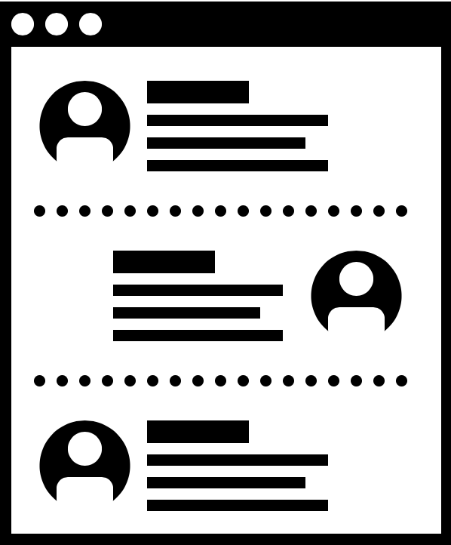

Task 6: Develop characters through role play
Interact as a character in a role play forum
thenounproject.com

Slide 16
Three Designs

Slide 17
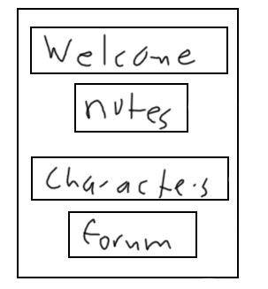
Design 1: Phone app with desktop compatibility

Slide 18
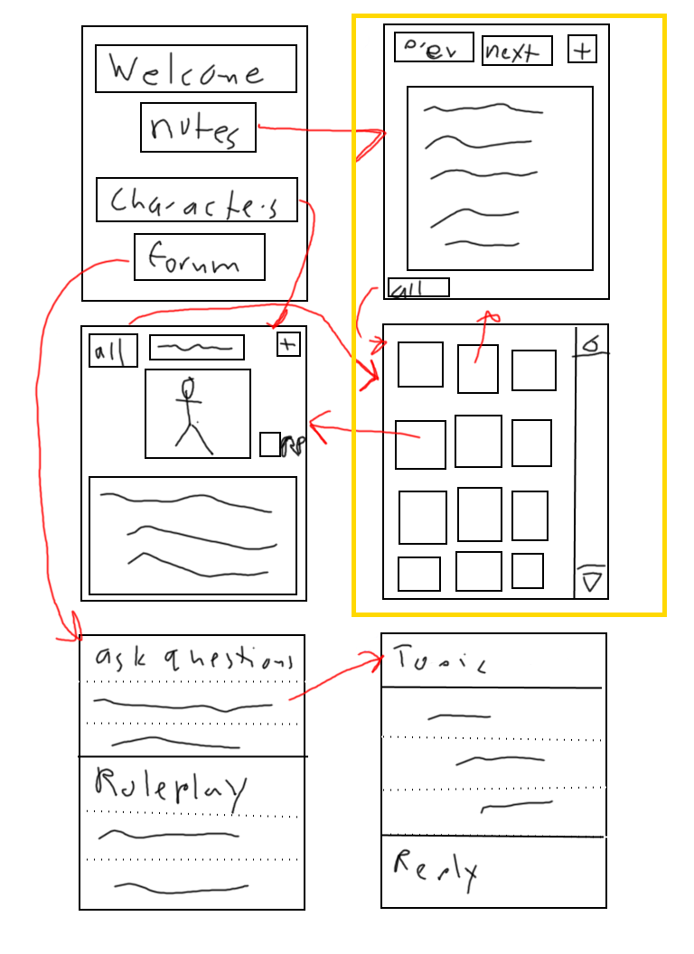
Quick Notes
Quickly add in notes in any format
Browse through their previous notes
Can choose which notes to import and which to delete

Slide 19
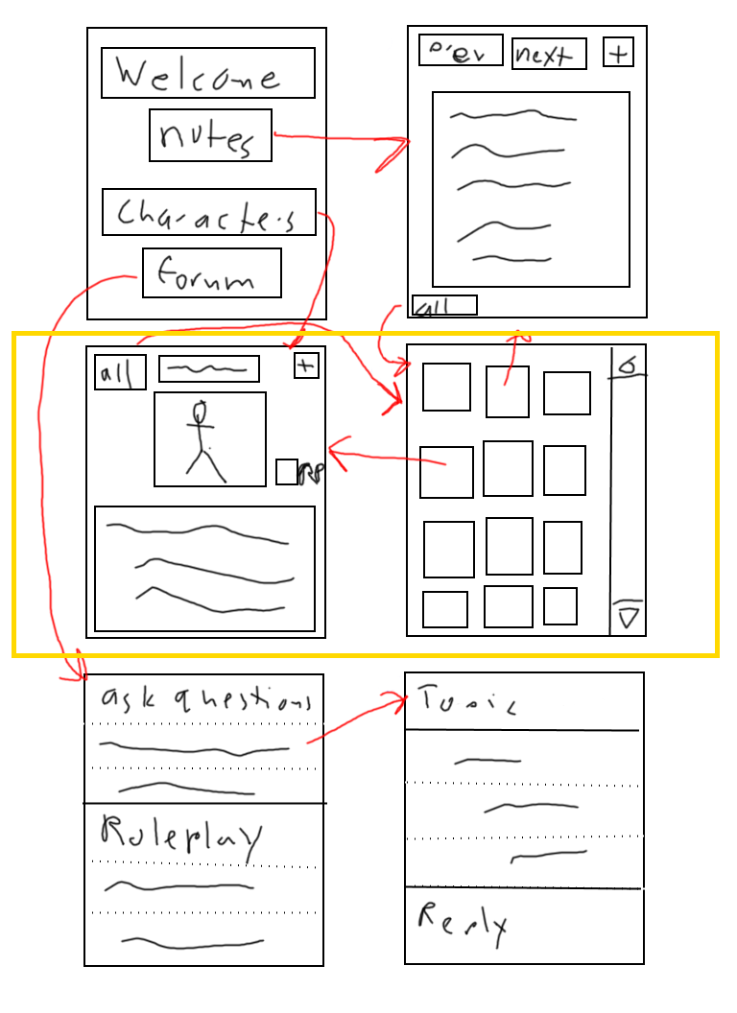
Character Bios
Allows the user to design characters and fill in fields given
Can add more easily
Gives the option to turn on sharing in the roleplay chat

Slide 20
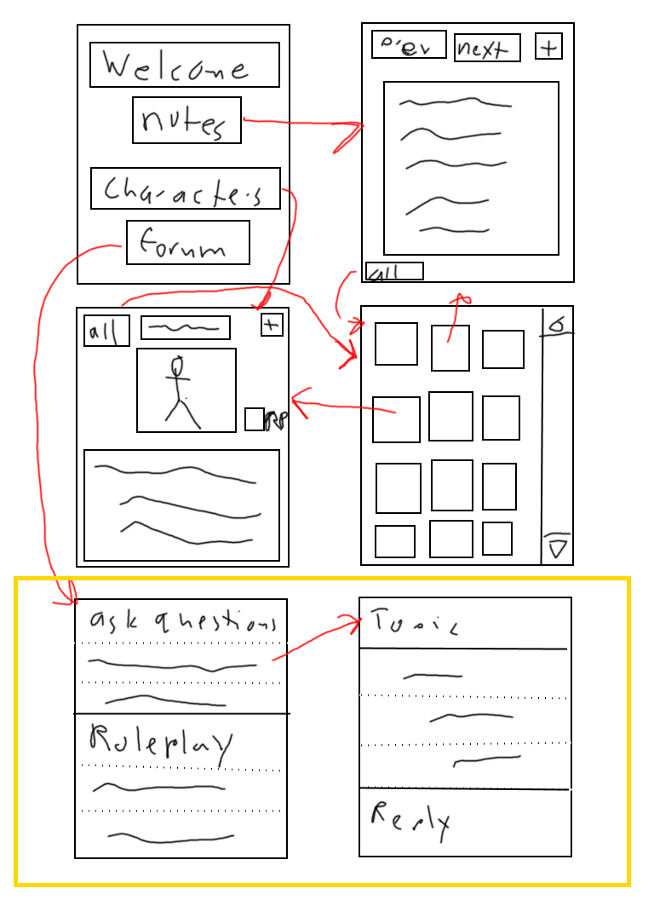
Forums
Has an option for roleplay
Has an option for feedback and asking questions
Similar structure for both
Different content in each
Allows for roleplay with characters created in the bio
Allows for quick and direct feedback and ideas

Slide 21
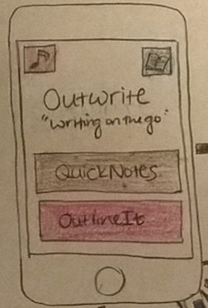
Design 2: Stand-alone phone app

Slide 22
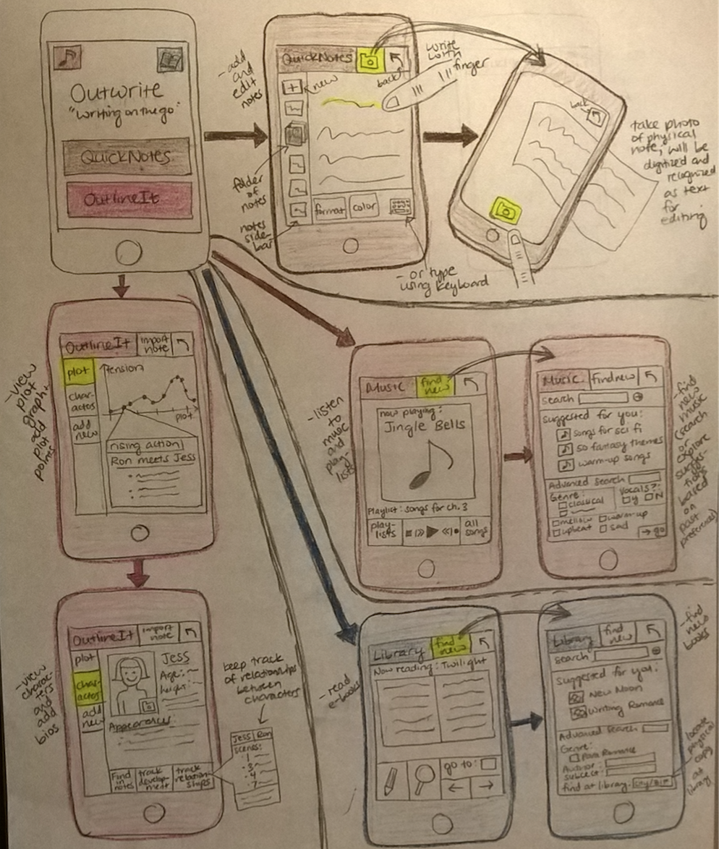
OutlineIt
Create plot graph with plot points
Store character bios
Character names tagged in plot graph

Slide 23
QuickNotes
Upload images of physical notes
Write on screen with finger or stylus
Type notes on screen
Character names tagged in plot graph

Slide 24
Music
Listen to playlists
Search for new music out of writing-appropriate suggestions

Slide 25
Library
Read e-books
Search for new books in genre
Find copies at local libraries

Slide 26
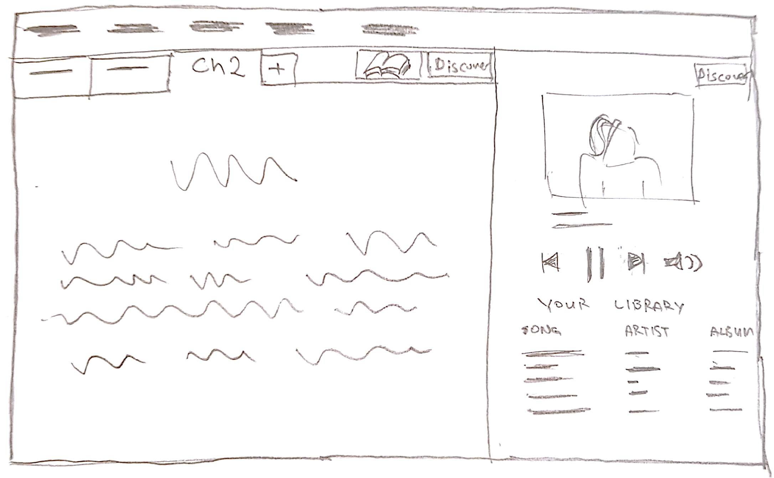
Design 3: Stand-alone desktop app

Slide 27
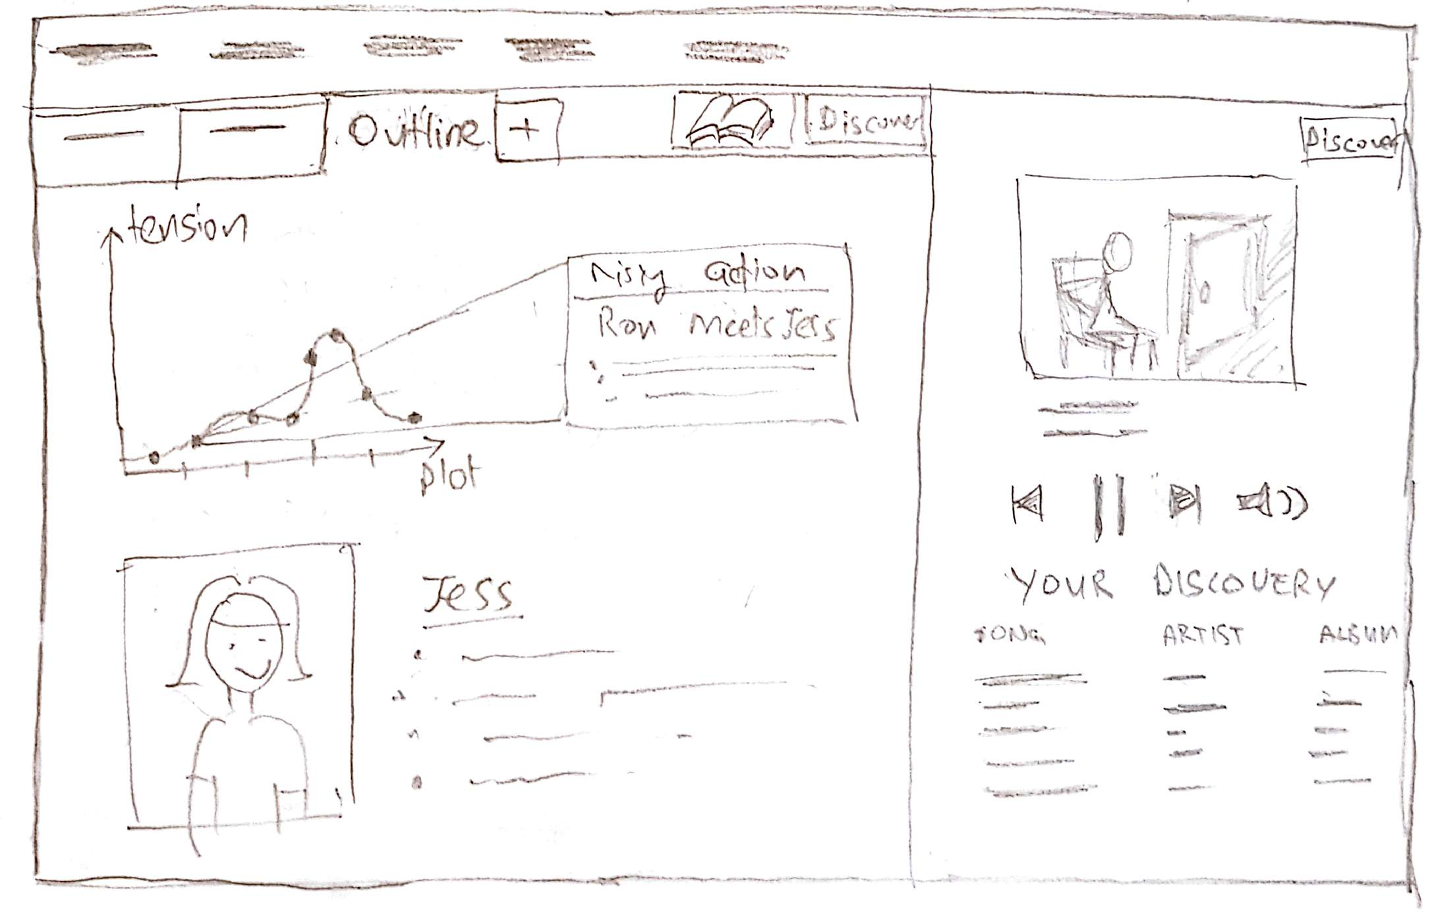
Outline
Create plot graph with plot points
Store character bios
Character names tagged in plot graph

Slide 28
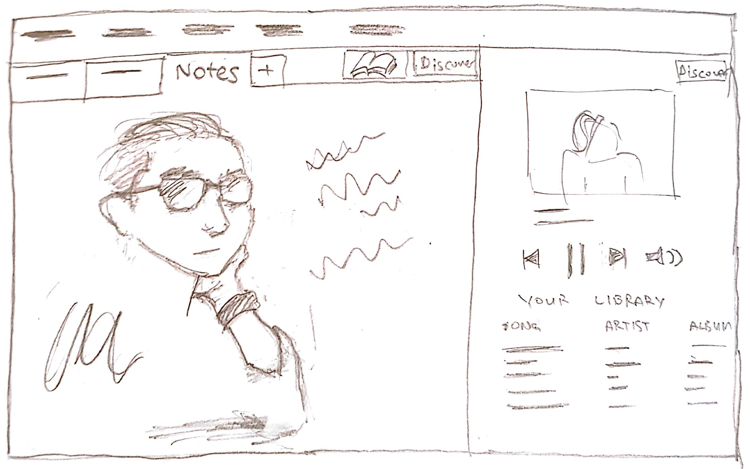
Notes
Upload images of physical notes as a new tab
Write in text boxes over handwritten notes
Type notes on screen

Slide 29
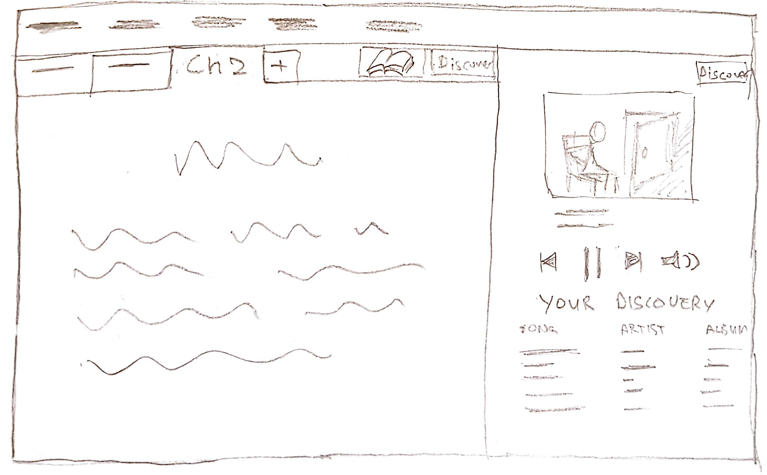
Discover Music
Listen to your own music library on your PC or music streaming services
Search for new music out of writing-appropriate suggestions using the Discover button

Slide 30
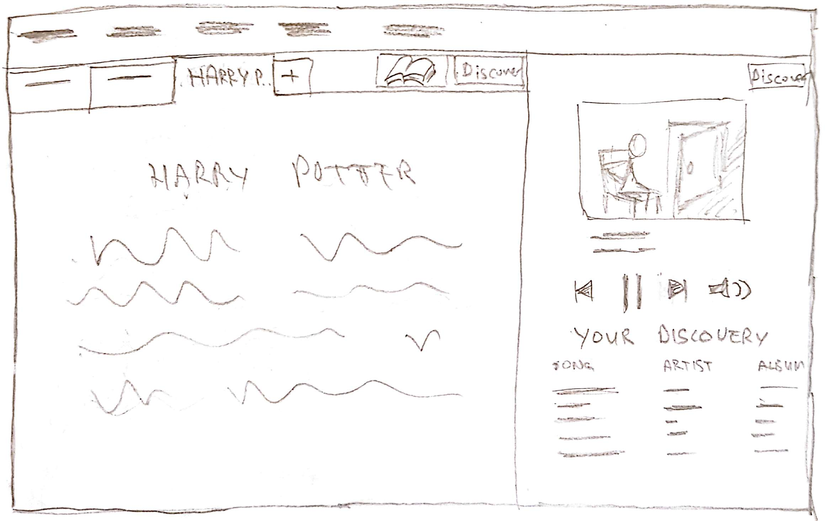
Discover Books
Find and Read e-books using the Book icon
Search for new books in genre using the Discover button

Slide 31
Selected Design

Slide 32
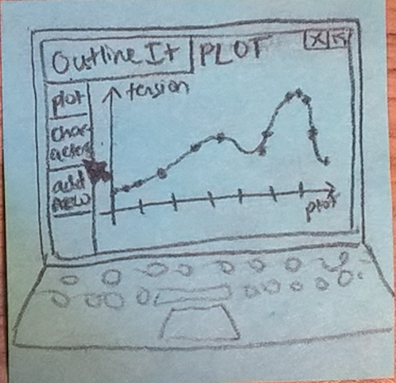
Selected Design
Phone app with desktop compatibility
Supports the following tasks:
Take notes on the go
Chart plot and character details
Chosen tasks mirror most common existing behaviors among participants
Initially designed a stand-alone phone app
Revised to add desktop support for referencing notes and outlines while writing on a computer

Slide 33
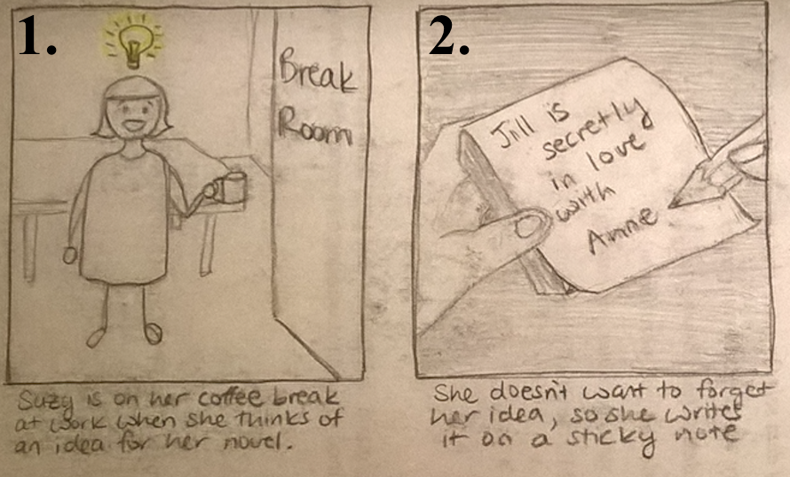
Storyboard 1

Slide 34
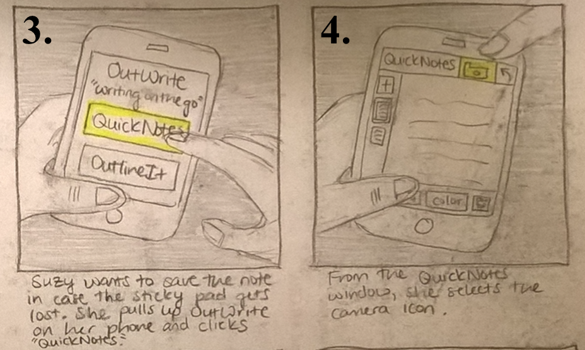
Storyboard 1 (cont.)

Slide 35
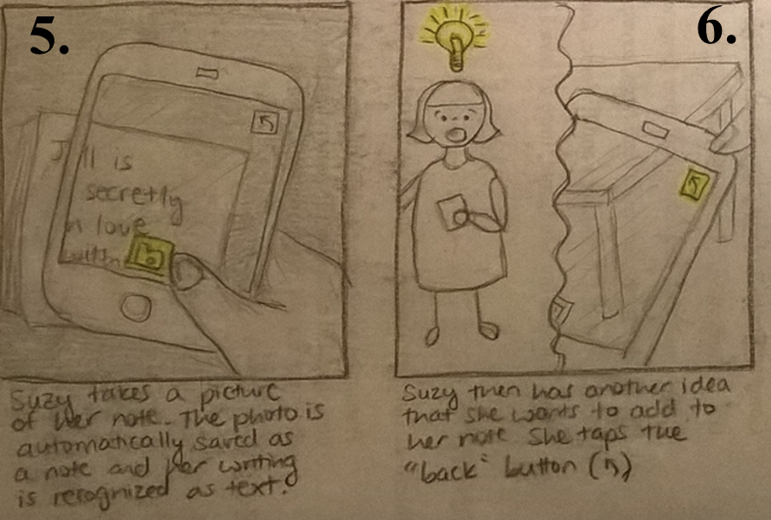
Storyboard 1 (cont.)

Slide 36
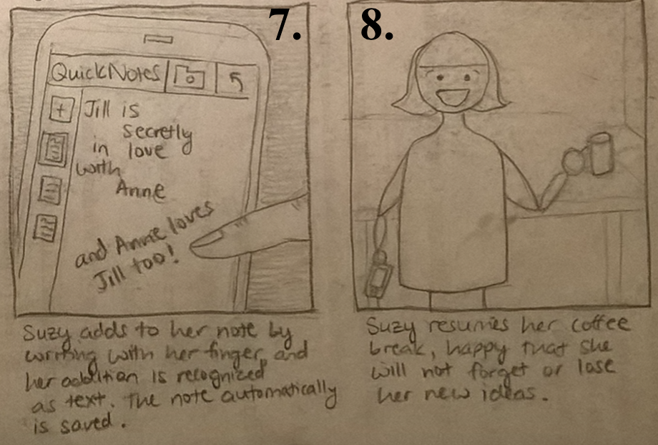
Storyboard 1 (cont.)

Slide 37
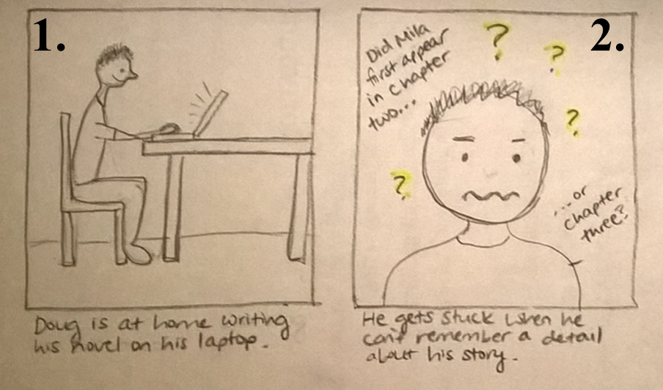
Storyboard 2

Slide 38
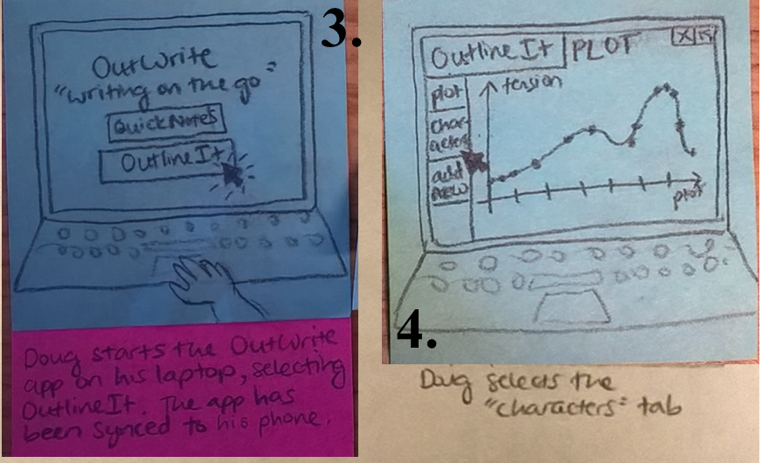
Storyboard 2 (cont.)

Slide 39
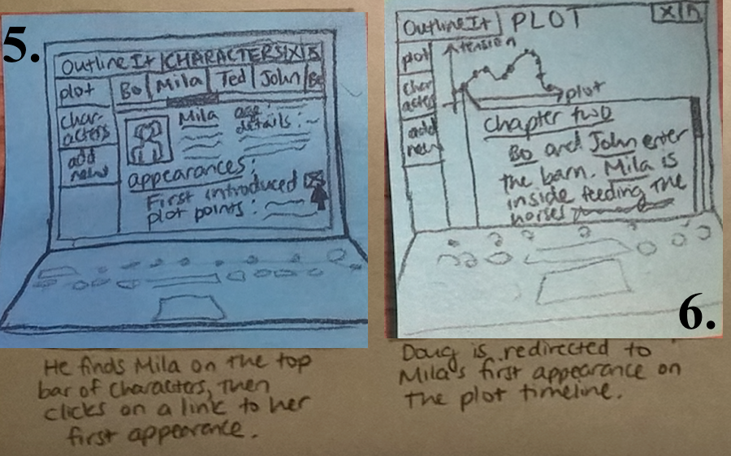
Storyboard 2 (cont.)

Slide 40
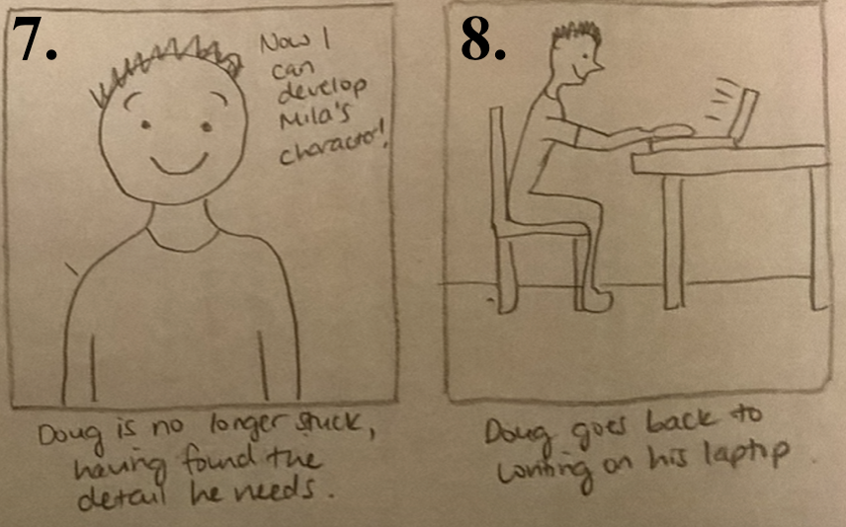
Storyboard 2 (cont.)

Slide 41
Summary
Design research revealed that there is currently no single tool that unifies and defines the process a fiction writer would use
Tools for taking notes and making outlines that can easily be incorporated into your novel are especially lacking
Our selected design addresses these problems -- a phone app that gives the user access to create, view, and manage plot and character details, and any other relevant notes

Slide 42
OutWrite
Image from thenounproject.com

